Slide 1
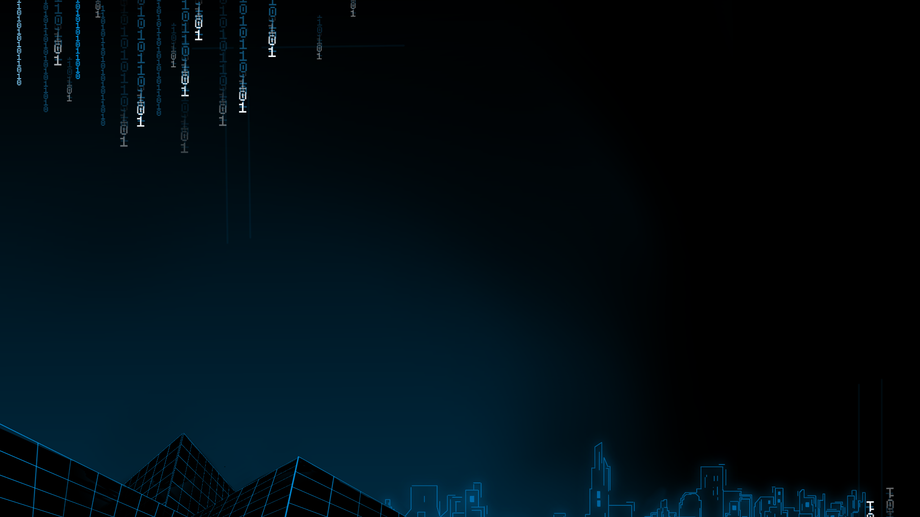
IBM Z Xplore ft. DevSoc
An introduction to Mainframes and the IBM Learning Platform

Slide 2


ZXP Checklist:
Register for the event here:
https://ibmzxplore.influitive.com/
Install Node.js (This will install NPM which you’ll need later on)
https://nodejs.org/en/
Install VS Code (You’ll need this to connect to IBM’s z15): https://code.visualstudio.com/download
Important VS Code Plugins:
Zowe Explorer
IBM Z Open Editor

Slide 3

What is ZXP?
It’s an annual event run by IBM (Previously MTM) to help folks learn a new set of skills in relation to a relatively niche piece of technology.
Over the course of the event, you’ll refine your understanding of some languages (i.e. Python) while also picking up a few new ones such as COBOL, JCL, REXX to name a few.
Developing some level of familiarity with these languages and technologies will help you broaden your skill set as a developer …

Slide 4
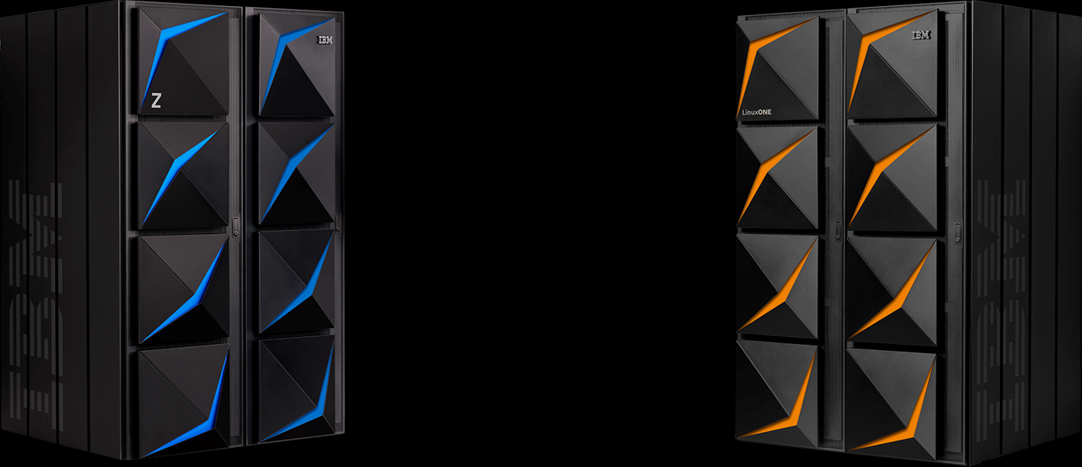
What is a Mainframe?
“ At their core, mainframes are high-performance computers with large amounts of memory and processors that process billions of simple calculations and transactions in real time.
The mainframe is critical to commercial databases, transaction servers, and applications that require high resiliency, security and agility. ”
- IBM
Notes:
As you progress along the exercises you’ll soon learn about this but essentially, as you complete each challenge you’ll be using one of these mainframes. You’ll sort of have a “section” of it all to yourself to fiddle with. Though, try your best not to break it like some of us did when they first launched the event.

Slide 5
SETUP GUIDE
Notes:
Get ready to following along with one of our instructors ...

Slide 6
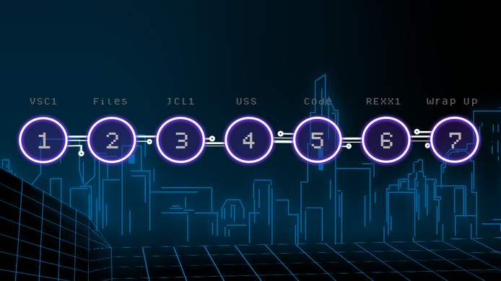

Slide 7
SUPPORT SESSION
Notes:
Get ready to following along with one of our instructors ...

Slide 8
Resources:
https://www.ibm.com/it-infrastructure/z/education/master-the-mainframe
https://www.ibm.com/it-infrastructure/servers/mainframes
https://www.ibm.com/uk-en/products/z15/details
https://jlelliotton.blogspot.com/2019/09/ibm-z15-and-ibm-linuxone-iii-announced.html?m=0
Notes:
Some resources we used to make this presentation

